Slide 1

Session Name:
Variants of the Simplex Method
Delivered By:
Mr. Ritwik Sinha

Slide 2

Simplex Method
The Simplex Method is a widely used algorithm for solving Linear Programming Problems (LPPs). Several variants of the Simplex Method exist to handle different types of LP problems efficiently
Types of different Simplex Method are:
Standard Simplex Method
Dual Simplex Method
Revised Simplex Method
Big-M Method
Two-Phase Simplex Method
Primal-Dual Simplex Method
Interior Point Method

Slide 3

Learning Objectives
By the end of this session, you will be able to:
Discuss different types of Simplex Method
Understand the applications of Simplex Method variants
Practice Simplex Methods questions

Slide 4
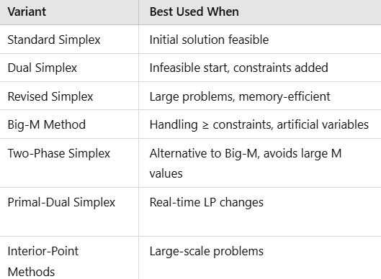
Table of Simplex Variants

Slide 5
Applications
Standard Simplex Method:- Production optimization, resource allocation, profit maximization
Dual Simplex Method:- Sensitivity analysis, post-optimality analysis, economic planning
Revised Simplex Method:- Large-scale industrial planning, logistics, finance, and network optimization
Big-M Method:- Complex manufacturing constraints, supply chain logistics, scheduling
Two-Phase Simplex Method:- Transportation problems, workforce planning, diet optimization
Primal-Dual Simplex Method:- Dynamic resource allocation, real-time optimization, economic modeling
Interior-Point Methods:- High-dimensional data analysis, machine learning, large-scale optimization

Slide 6
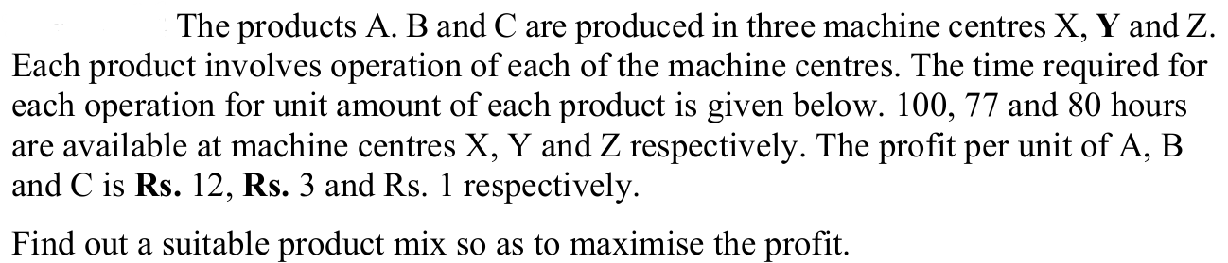
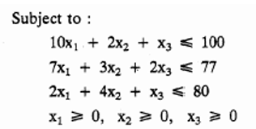

Simplex Method with several Decision Variables
Hint:
Optimization Function:- Maximize $12x_{1}+3x_{2}+x_{3}$

Slide 7

$x_{1}+x_{2}=4$
vbvbn

Slide 8
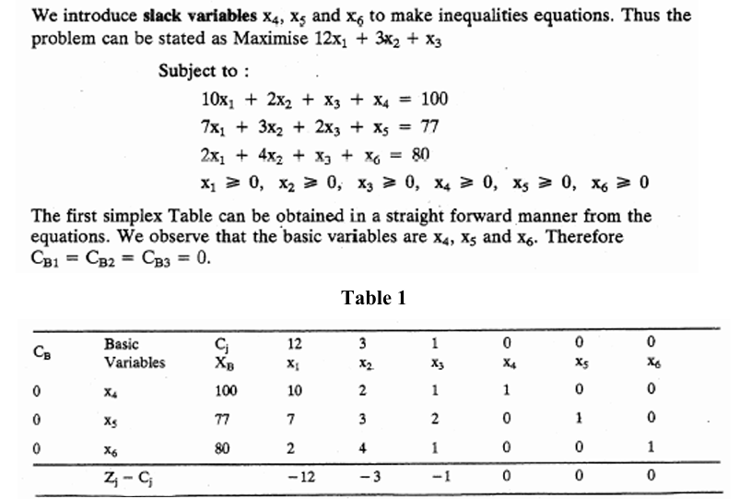
Solution

Slide 9
Session Summary
In this session, we have discussed about:
Different variants of Simplex Method
Practicing the question on Simplex Method
Python implementation of Simplex Method variants

Slide 10

Happy Learning!

